Slide 1
Kubernetes <Code> Components

Slide 2
Idan Shahar
Cloud Solution Architect @Microsoft
www.linkedin.com/in/idan-shahar
github.com/idanshahar
idans@microsoft.com

Slide 3
AKS – Our Managed K8s Cluster
Fully managed Kubernetes cluster
SLA-available service (99.95%) ~4h 22m 58.8s Yearly
Transparently scales with cluster size:
1, 50, 100, 250, 500 …
Upstream Kubernetes
Works with the echosystem
Helm & Draft support
Only pay for compute

Slide 4
Fully Managed?
Log Analytics
& OMS
Node Scale
One Click!
1.8.1!
Upgrade?
One Click!
Kubernetes
Dashboard
Kubernetes
Cluster In One Click!
kubectl
Azure Files
Persist data
Minor & Patch-level Upgrades
No VMs to Operate
SSD-Backend
Notes:
Kubernetes cluster in one click
Upgrade
Node scale
No VMs operation
SSD-backend
The Familiar kubectl
Auto patching & minor upgrades
Azure files for persist data
The familiar Kubernetes dashboard
Application log monitoring with Azure Log analytics

Slide 5
Helm
The Package Manager for Kubernetes.
It simplify the process of installing and managing
applications on Kubernetes Cluster

Slide 6
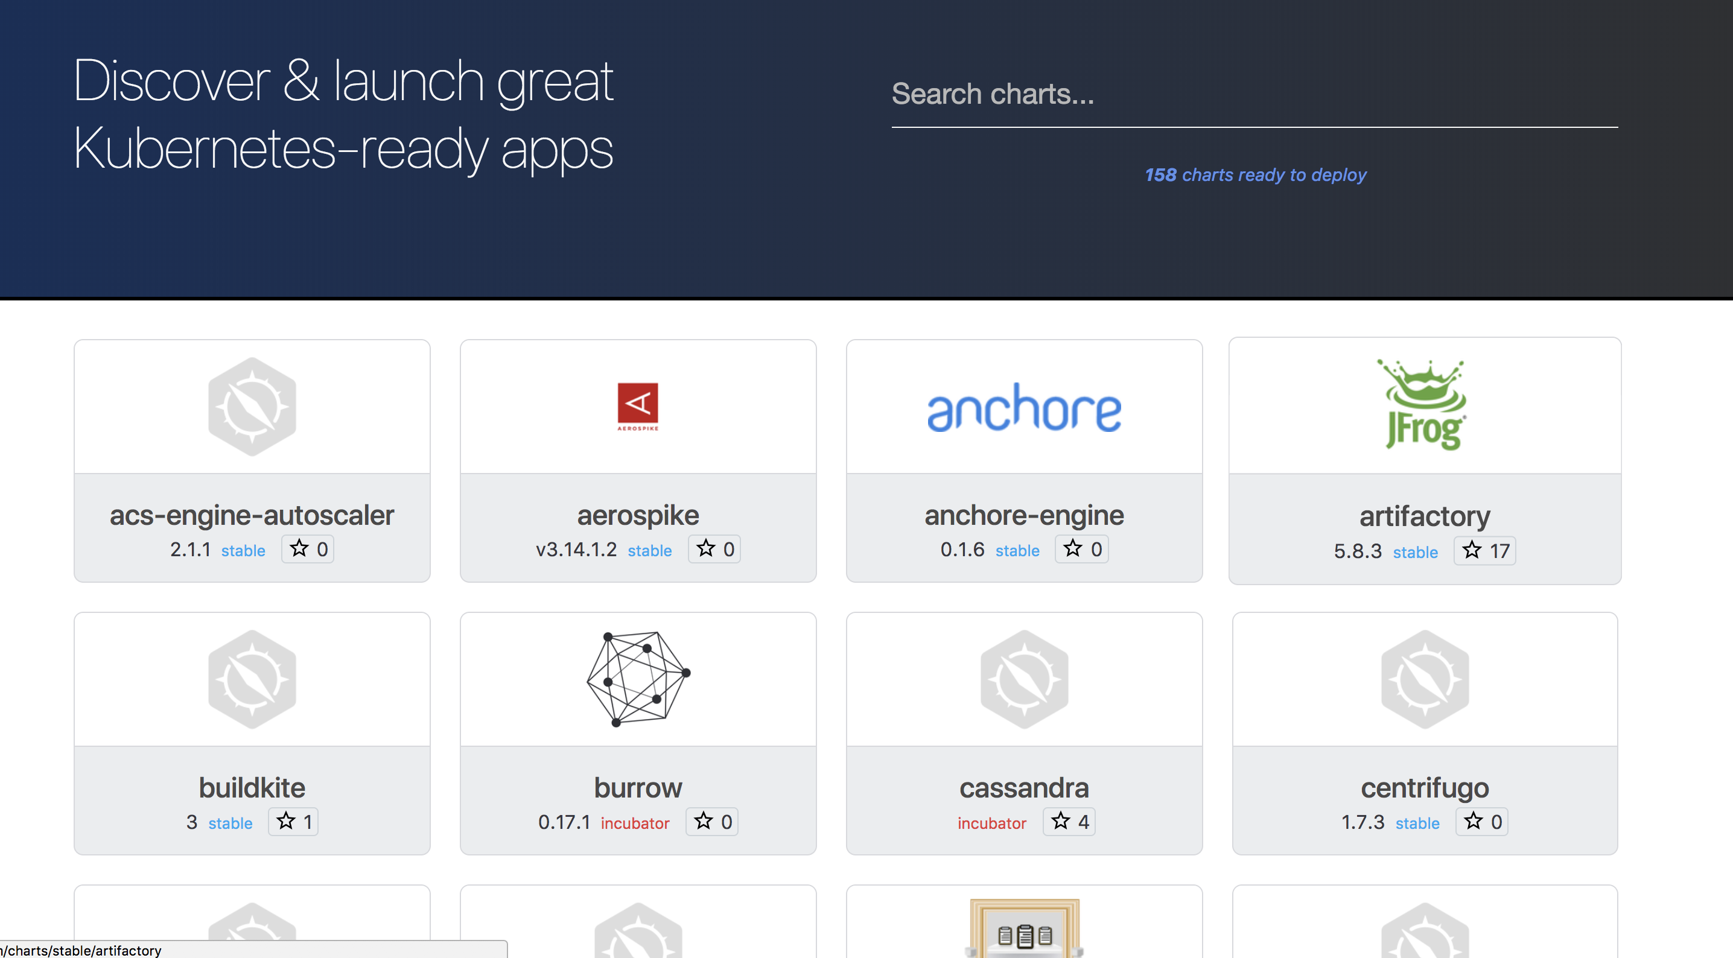

Slide 7
Demo CI/CD Pipeline with Jenkins & Helm

Slide 8
Draft
A developer tool for authoring Microservices for Kubernetes

Slide 9
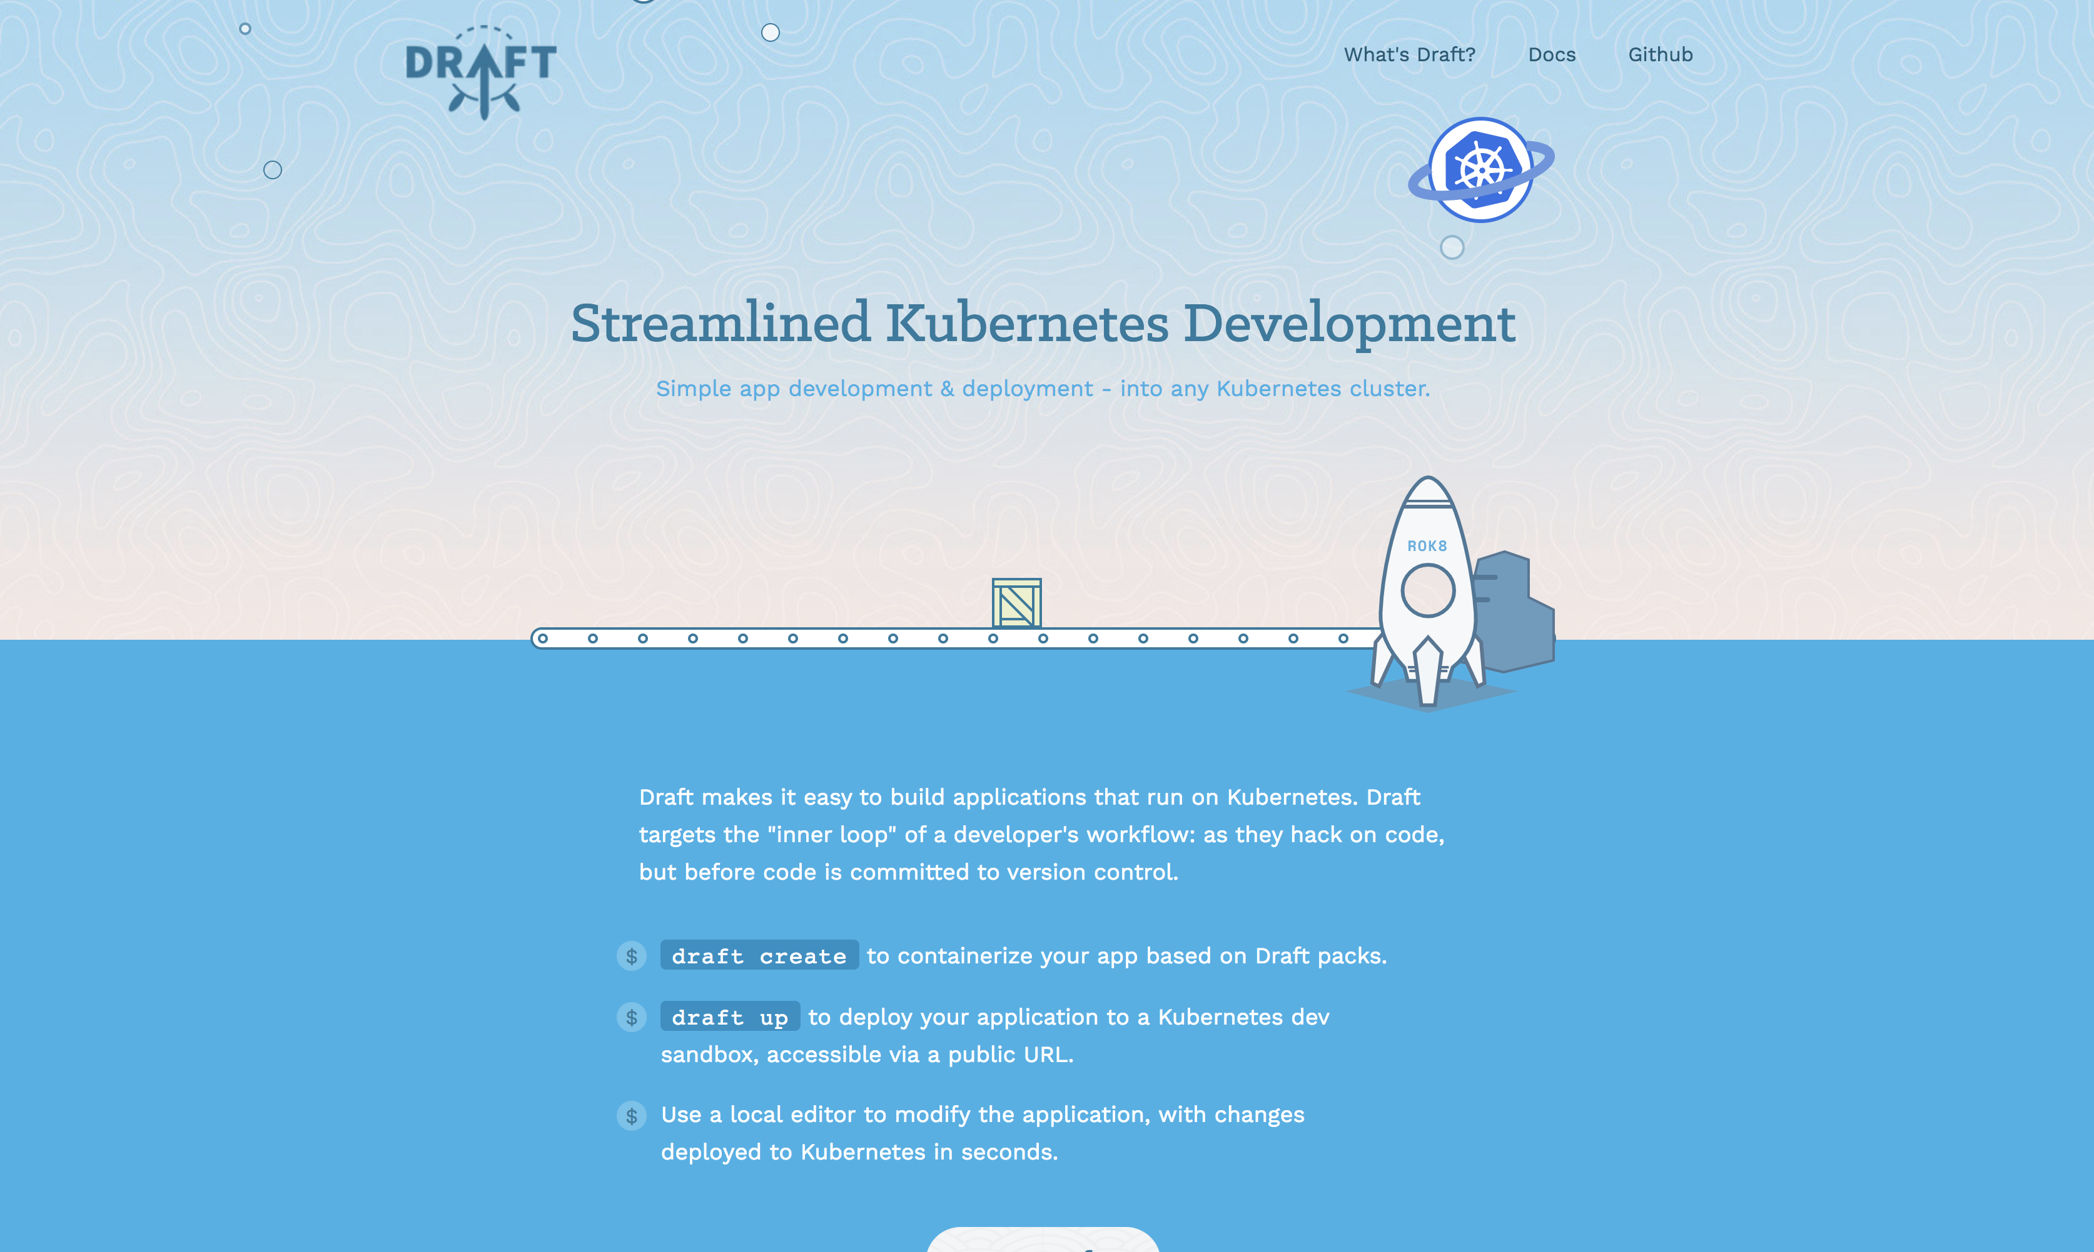

Slide 10
Demo Build (and Deploy) a node.js Docker Image in One Command!

Slide 11
Monitoring

Slide 12
K8s Monitoring Solutions
Kubernetes monitoring architecture is in a redesign process
Resource Metrics API
Heapster
Metrics Server
Custom Metrics API
Prometheus Adapter
Google Stackdriver (coming soon)

Slide 13
Demo Heapster+InfluxDB+Grafana

Slide 14
Questions?

Slide 15
Win a pop!

Slide 16
Thanks!

